Slide 1
Project architecture

Slide 2
Front End
Front End
> SRC
>Assets, Components, Views, Services

Slide 3
Assets
Stores any external findings
Eg. Images, Sounds, Videos

Slide 4

Components
Where to store any smaller pieces of code that make 1 component
Such as header, footer, browse

Slide 5

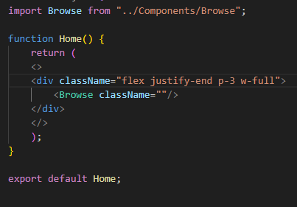
Views
Stores a frontend page
Made up of components
Home.jsx:

Slide 6
Services
Stores the api call to retrieve the data from the backend
Using axios library

Slide 7
Backend
ASP.net web api
Backend > Models, Data, Controllers

Slide 8
Models
Stores the data models for each individual table

Slide 9
Data
Stores the db context (all the tables within the database)

Slide 10
Controllers
Stores the end points for the data
Eg. (get, post)

Slide 11
Whole architecture
Front end -> Services -> ASP.net -> SQL DB
The front end stores the services that make the api call to asp.net backend
ASP.net retrieves the data from the database and returns it

